Slide 1
Assignment 1 Video Summarization

Slide 2
Rules
2
Programs must be based on C/C++ or Python w/wo window interface
No later submission
Presentation slides are necessary
The submission due date is 03/24/2025 23:59
The presentation date is on 03/26/2025
The presentation should all be in English

Slide 3
Requirements
2
Please complete the following guidelines:
Consider addition video/audio features.
Design your own algorithm to implement the video summarization.
Report the evaluation metrics and output videos.
Note : Please indicate the frame index where the predicted moments are.

Slide 4
Datasets
4
Number of test videos : 3
video1^{[1]} (w/ GT) (~104s)
video2^{[1]} (w/ GT) (~98s)
video_youtube^{[2]} (w/o GT) (~427s)
Ground Truth (GT) contains 20 people’s annotations, therefore evaluate each and only select the best score.
(More information can be found at code)
[1] Zhu, Wencheng, Jiwen Lu, Jiahao Li and Jie Zhou. “DSNet: A Flexible Detect-to-Summarize Network for Video Summarization.” IEEE Transactions on Image Processing 30 (2020): 948-962.
[2] https://www.youtube.com/watch?v=utvQE2WpHCU&t=24s

Slide 5
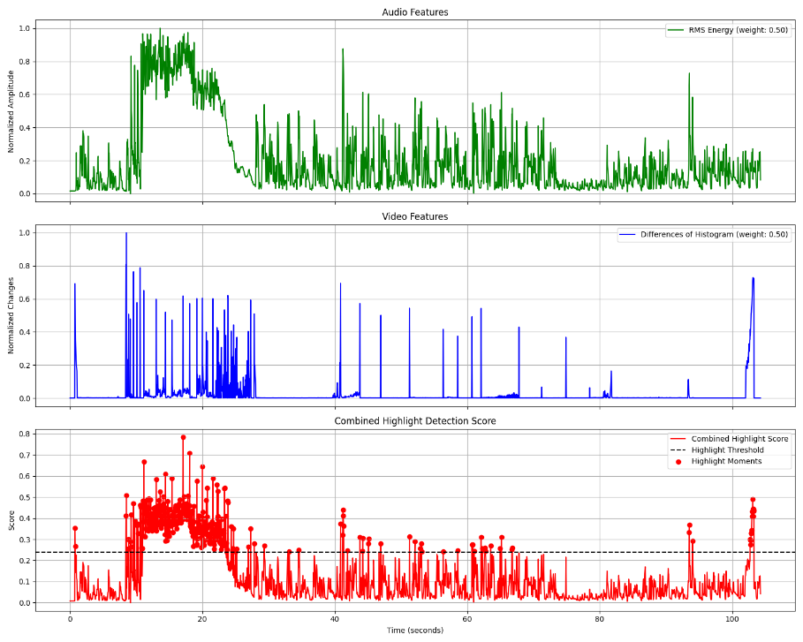
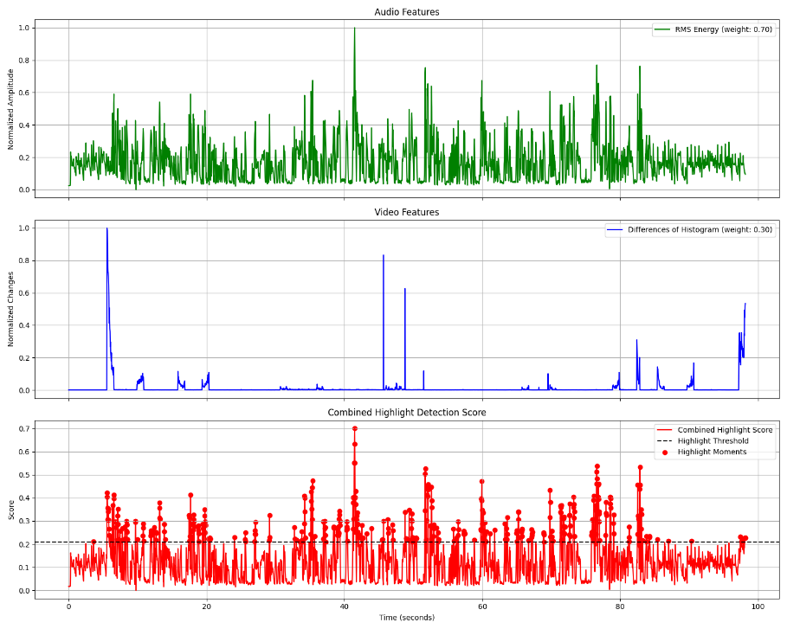
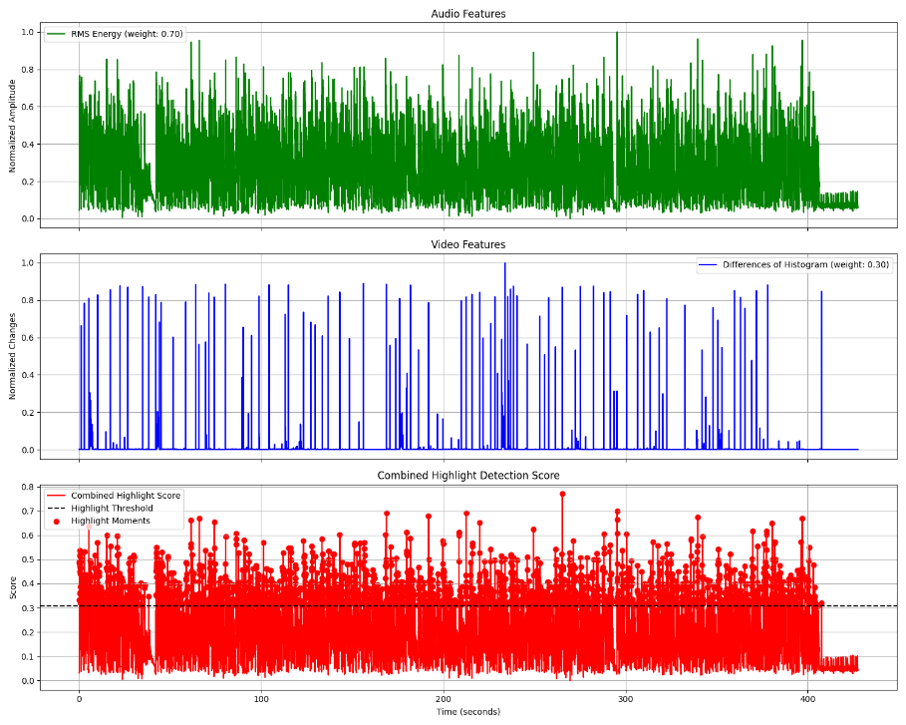
Baseline Code
2
We provide the code using RMS Energy and Differences of Histogram to determine the target moment.
Video1
Video2
Video_youtube

Slide 6
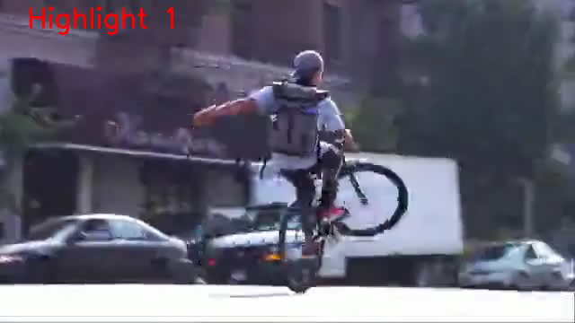
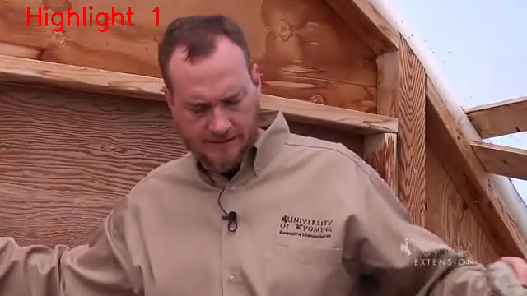

Experimental Results
2
Please provide the following metrics and videos in your assignment.
Method | F1-Score | Video 2 | Precision |  | Recall
 | Video 1 | Video 2 | Video 1 | Video 2 | Video 1 | Video 2
Baseline | 0.212 | 0.188 | 0.203 | 0.200 | 0.222 | 0.179
Video1
Video2
Video_youtube

Slide 7
Baseline code of video summarization
4
Download links:
Directory Structure:
114_2_assignment1/
…videos/
……/video1.mp4
……/video2.mp4
…labels/
……/video1.json
……/video2.json
summarization.py
README.md

